Slide 1
Design of High Performance Internet Routers
(高效能網際網路路由器設計)
張 燕 光
資訊工程學系
Dept. of Computer Science & Information Engineering,
國立成功大學
National Cheng Kung University

Slide 2
Outline
Introduction
IP lookup review (1-D packet classification)
Data structures for IP lookups
Binary prefix search
Layered search trees
5-D packet classification
Openflow (Software Defined Network, SDN)
12-D packet classification
Conclusion

Slide 3
Internet: Mesh of Routers
The Internet Core
Edge Router
Campus Area
Network

Slide 4
RFC 1812: Requirements for IPv4 Routers
Must perform an IP datagram forwarding decision (called forwarding, routing lookup, or IP lookup, longest prefix match)
Must send the datagram out to the appropriate interface (called switching)

Slide 5
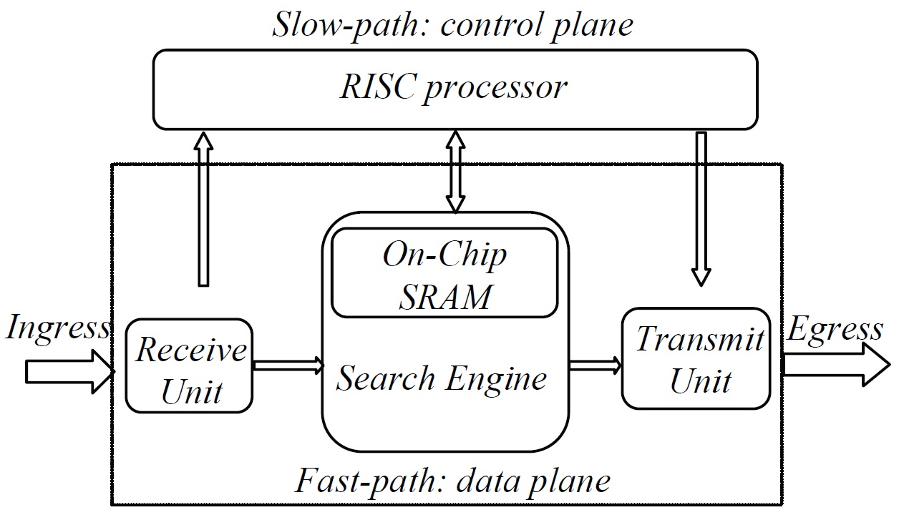
IP Router

Slide 6
Search Engine
HEADER
Forwarding Engine
Next Hop
Dstn
Addr
Next Hop Computation
Forwarding Table
Dstn-prefix
Next Hop
----
----
----
----
Incoming
Packet
----
----
Unicast destination address based lookup

Slide 7
IPv4 Addresses
32-bit addresses
Dotted quad notation: e.g. 12.33.32.1
Can be represented as integers on the IP number line [0, 2³²-1]: a.b.c.d denotes the integer: (a*2²⁴+b*2¹⁶+c*2⁸+d)
IP Number Line
0.0.0.0
255.255.255.255

Slide 8
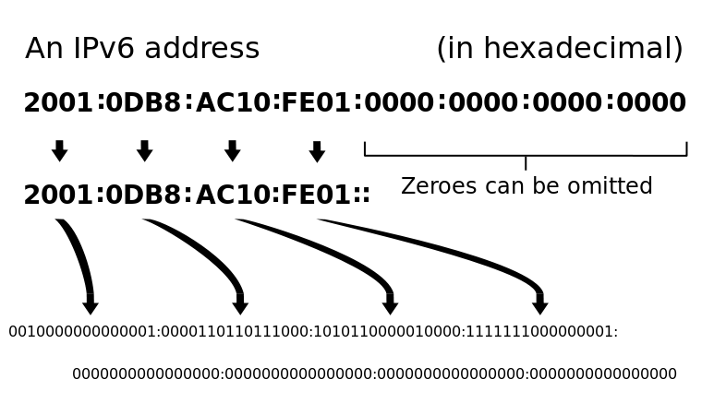
IPv6 Addresses
128-bit addresses

Slide 9
Example Forwarding Table
 | Prefix | Next-hop
P1 | 111* | H1
P2 | 10* | H2
P3 | 1010* | H3
P4 | 10101 | H4
Longest prefix match(LPM), not exact match
Properties: prefixes are either disjoint or enclosing (one completely covers another)
Prefix enclosure makes (1) sorting prefixes and (2) binary searching prefixes difficult.
So, trie based schemes emerge naturally

Slide 10
Data Structures for
IP lookups

Slide 11
Prefix properties
Disjoint prefixes:
  Two prefixes are said to be disjoint if they do not share any address.
Prefix enclosure:
  A = b_{n-1}…b_{j}…b_{i}* and B = b_{n-1}…b_{j}* and j > i.
  Prefix A is enclosed by B (B ⊇ A) since the IP address space covered by A is a subset of that covered by B, where ⊇ is the enclosure operator.
  A special case of overlapping.
Prefix comparison
  The inequality 0 < * < 1 is used to compare two prefixes in the ternary representation of prefixes.

Slide 12
Prefix properties
The most specific prefixes (MSP):
  The prefixes that do not cover any others.
  Disjoint, so can be put in an array for binary search
Grouping prefixes in layers based on MSP.
  6-7 layers for IPv4 tables
5
4
4
3
3
3
3
2
2
2
2
2
2
2
2
1
1
1
1
1
1
1
1
1
1
1
1
1
1
1
1

Slide 13
Prefix Enclosure property
Database (year-month) | AS6447 (2000-4) | AS6447 (2002-4) | AS6447 (2005-4)
number of prefixes | 79,530 | 124,798 | 163,535
Level-1 prefixes | 73,891(92.9%) | 114,745 (91.9%) | 150,245 (91.9%)
Level-2 prefixes | 4,874 (6.1%) | 8,496 (6.8%) | 11,135 (6.8%)
Level-3 prefixes | 642 (0.8%) | 1,290 (1%) | 1,775 (1.1%)
Level-4 prefixes | 104 (0.1%) | 235 (0.2%) | 329 (0.2%)
Level-5 prefixes | 17 | 29 | 45
Level-6 prefixes | 2 | 3 | 6

Slide 14
Prefix Enclosure property
Layer distribution
Notes:
layer 0 佔絕大部分 (90 %) → 大多數 match 在 layer 0
14

Slide 15
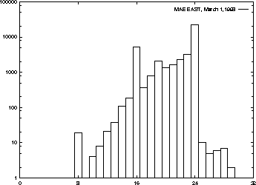
Prefix properties
Number
Prefix length

Slide 16
Prefix
Forwarding table example
 | Prefix | Next-hop
P1 | 111* | H1
P2 | 10* | H2
P3 | 1010* | H3
P4 | 10101 | H4
P1 is disjoint from the other three prefixes.
P2 ⊇ P3 ⊇ P4
Longest prefix match(LPM), not exact match
enclosure makes (1) sorting prefixes and (2) binary searching prefixes difficult
So, trie based schemes emerge naturally

Slide 17
Binary Trie (Radix Trie)
Trie node
Lookup 10111
A
next-hop-ptr (if prefix)
1
B
left-ptr
right-ptr
P1 | 111* | H1
P2 | 10* | H2
P3 | 1010* | H3
P4 | 10101 | H4
1
C
0
D
Add P5=1110*
P2
1
1
E
F
P1
G
0
0
P3
P5
I
1
H
P4

Slide 18
Binary Trie: Leaf Pushing
P1 | 111* | H1
P2 | 10* | H2
P3 | 1010* | H3
P4 | 10101 | H4
P5 | 1110 | H5
P2
P2
P5
P1
Disjoint,
but duplication
P3
P4

Slide 19
Prefix formats (representation)
Length format: b_{n-1}…b₀/l (l is prefix length)
  In IPv4, d3.d2.d1.d0/l , 140.116.82.36/24 .
Mask format: b_{n-1}…b₀/m_{n-1}…m₀ (prefix length is l)
  m_{j} = 1 for all n – 1 ≥ j ≥ n – l, and m_{j} =0 otherwise.
  d₃.d₂.d₁.d₀/ m₃.m₂.m₁.m₀, 140.116.82.36/1...100000000
Ternary format: b_{n-1}…b_{n-l+1}*…* (prefix length is l)
  140.0.0.0/8 = 10001100*

Slide 20
A New Prefix format
(n+1)-bit format: b_{n-1}…b_{n-l}10…0 (l is prefix len)
  for the prefix b_{n-1}…b_{n-l}* of length l in ternary format, there is one trailing ‘1’ followed by n – l 0’s.
or symmetrically
(n+1)-bit format: b_{n-1}…b_{n-l}01…1
  for the prefix b_{n-1}…b_{n-l}* of length l in ternary format, there is one trailing ‘0’ followed by n – l 1’s.

Slide 21
5-bit Prefixes: b_{n-1}…b_{n-l}10…0
*****
0****
00***
11***
0
0
0
*
*
1
1
1
*
*
0
0
0
0
*
0
0
0
1
*
1
1
1
0
*
1
1
1
1
*
0
0
0
0
0
0
0
0
0
1
0
0
0
1
0
0
0
0
1
1
1
1
1
0
0
1
1
1
0
1
1
1
1
1
0
1
1
1
1
1
0
0
0
0
0
1
0
0
0
0
1
0
0
0
0
0
1
1
0
0
0
1
0
0
0
0
0
1
0
1
0
0
0
1
1
0
0
0
0
1
1
1
0
0
1
0
0
0
1
1
1
0
0
0
1
1
1
0
0
1
1
1
1
0
1
0
1
1
1
0
1
1
1
1
1
1
0
0
1
1
1
1
0
1
1
1
1
1
1
0
1
1
1
1
1
1
6-bit binary address space
000000 is not used

Slide 22
5-bit Prefixes: b_{n-1}…b_{n-l}01…1
*****
0****
00***
11***
0
0
0
*
*
1
1
1
*
*
0
0
0
0
*
0
0
0
1
*
1
1
1
0
*
1
1
1
1
*
0
0
0
0
0
0
0
0
0
1
0
0
0
1
0
0
0
0
1
1
1
1
1
0
0
1
1
1
0
1
1
1
1
1
0
1
1
1
1
1
0
0
0
0
0
0
0
0
0
0
0
1
0
0
0
0
1
0
0
0
0
0
1
1
0
0
0
1
0
0
0
0
0
1
0
1
0
0
0
1
1
0
0
0
0
1
1
1
1
1
0
1
1
1
1
1
1
0
0
0
1
1
1
0
0
1
1
1
1
0
1
0
1
1
1
0
1
1
1
1
1
1
0
0
1
1
1
1
0
1
1
1
1
1
1
0
6-bit binary address space
111111 is not used

Slide 23
Prefix: a special case of Range
Range format: [b, e], b and e are begin and end endpoints
Prefixes are special cases of ranges.
Prefix b_{n-1}…b_{n-l}* of length l is the range of addresses from b_{n-1}…b_{n-l}0…0 to b_{n-1}…b_{n-l}1…1,
denoted as [b_{n-1}…b_{n-l}0…0, b_{n-1}…b_{n-l}1…1] or b_{n-1}…b_{n-l}*.
Overlapping:
  Two ranges are overlapping if they are not disjoint.
Partially overlapping:
    Two ranges are partially overlapping if they are neither disjoint nor enclosing.
    So, two prefixes can not be partially overlapped
The source/destination port fields of rule tables for packet classification are ranges.

Slide 24
Elementary Intervals for Ranges
Definition: Let the set of k elementary intervals constructed from a set R of ranges in the address space of 0 … N – 1 be
X = {X_{i} | X_{i} = [e_{i}, f_{i}], for i = 1 to k}.
X must satisfy the following:
  e₁ = 0 and f_{k} = N – 1,
  f_{i} = e_{i}+1 – 1 for i = 1 to k – 1,
  all addresses in X_{i} are covered by the same subset of R (called the range matching set of X_{i}) denoted by EI_{i}, and
  EI_{i} ≠ EI_{i}+1, for i = 1 to k – 1.

Slide 25
Elementary Intervals for Ranges
Graphical view
P1 [0 , 15]
P2 [16, 31]
P3 [4 , 7]
P4 [32, 63]
P5 [22, 23]
P6 [48, 63]
P7 [48, 51]
P8 [55, 55]
P9 [32, 39]
EI₁
{P1}
X₁
[0, 3]
EI₂
{P1,P3}
X₂
[4, 7]
EI₃
{P1}
X₃
[8, 15]
EI₄
{P2}
X₄
[16, 21]
EI₅
{P2,P5}
X₅
[22, 23]
EI₆
{P2}
X₆
[24, 31]
P1
P2
P3
P5
EI₇
{P4,P9}
X₇
[32, 39]
EI₈
{P4}
X₈
[40, 47]
EI₉
{P4,P6,P7}
X₉
[48, 51]
EI₁₀
{P4,P6}
X₁₀
[52, 54]
EI₁₁
{P4,P6,P8}
X₁₁
[55, 55]
EI₁₂
{P4,P6}
X₁₂
[56, 63]
P4
P9
P6
P7
P8

Slide 26
Elementary Intervals for Ranges
ID Prefix Range Minus-1 Traditional
start finish start finish
P1 000000/2 [0, 15] - 15 0 15
P2 010000/2 [16, 31] 15 31 16 31
P3 000100/4 [4, 7] 3 7 4 7
P4 100000/1 [32, 63] 31 - 32 63
P5 010110/5 [22, 23] 21 23 22 23
P6 110000/2 [48, 63] 47 - 48 63
P7 110000/4 [48, 51] 47 51 48 51
P8 110111/6 [55, 55] 54 55 55 55
P9 100000/3 [32, 39] 31 39 32 39

Slide 27
Segment Tree
23
w
y
z
7
47
P1
u
v
q
P4P6
g
3
15
31
54
15
P3
P1
P2
X₁
[0,3]
X₂
[4,7]
X₃
[8,15]
P2
h
X₆
[24,31]
P4
r
s
t
21
39
51
55
leaf node
P5
P9
P7
P8
X₄
[16,21]
X₅
[22,23]
X₇
[32,39]
X₈
[40,47]
X₉
[48,51]
X₁₀
[52,54]
X₁₁
[55,55]
X₁₂
[56,63]

Slide 28
Hash Table
Narrowing down the search space.
Index = Hash_function(key)%m, where key may be the first k bits of IP addresses and m is the size of the hash table.
Perfect hash: no collision
Minimal perfect hash: A perfect hash, where the size of its hash table is k for k different hashing keys.
P1 | 111* | H1
P2 | 10* | H2
P3 | 1010* | H3
P4 | 10101 | H4
P5 | 1110 | H5

Slide 29
Hash Table
Difficulties: prefixes and ranges can not be used as the keys of the hash functions directly.
Array of m elements
H(k1)%m
k1
k2
H(k2)%m
collision

Slide 30
Hash Table
Prefix b_{n-1}…b₀/l = b_{n-1}…b_{n-l}0…0/l
Hash(b_{n-1}…b_{n-l}0…0, l) = h
  Store b_{n-1}…b_{n-l}0…0/l in bucket h of the hash table
  When Input IP = b_{n-1}…b₀
  We have to search multiple times as follows
  Hash(b_{n-1}…b_{n-i}0…0, i) for i = 1 to max_length

Slide 31
Hash Table: 8-bit Segmentation table
A 8-bit segmentation table is usually used for IPv4 forwarding tables because there is no prefix of length shorter than 8.
Array of 256 elements
0
Prefix: 0.x.y.z
H(prefix)%256
(MSB 8 bits of prefix)
1
Prefixes with the same first 8 MSB bits
Maybe empty set
255

Slide 32
Hash Table: 16-bit Segmentation table
Prefixes of length <= 16 must be stored properly.
  For example, duplicate 0.0.b.c/15 into buckets 0 and 1 or store the port of 0.0.b.c/15 into elements 0 and 1.
  Put them into another set (good for update but need to search two sets in the worst case).
Array of 2¹⁶ elements
0
Prefix: 0.0.y.z
H(prefix)%2¹⁶
(MSB 16 bits of prefix)
1
Prefixes with the same first 16 MSB bits
Maybe empty set
2¹⁶-1
Prefixes of length ≤ 16

Slide 33
Hash Table: Compression
Since there are many empty elements in the segmentation table, we can use bitmap to compress the segmentation table.
2¹⁶-Bitmap containing M 1’s
Array of M elements
1
1
0
0
.
.
.
0
1
1
0
0
1
0
Prefix: 0.0.y.z
1
Prefix: 0.1.y.z
Prefixes with the same first 16 MSB bits
Must be non-empty
M-1

Slide 34
Metrics for Lookup Algorithms
High Speed (ex. 40 Gbps/40-byte=128m packets/sec)
Small storage (ex. Cache or On-Chip memory)
Low update time
Ability to handle large routing tables
Flexibility in implementation
Low preprocessing time
IPv6

Slide 35
Survey: IP Lookups
M. A. Ruiz-Sanchez, E. W. Biersack, and W. Dabbous, “Survey and taxonomy of IP address lookup algorithms,” IEEE Network, vol. 15, pp. 8–23, March 2001.
Schemes for optimizing search speed
  Multibit tries
  Two-level multibit trie, 16-16, 24-8
  Binary range search (endpoint)
  Binary search on prefix length
  Binary prefix search
  Binomial Spanning tries based on Hamming and Golay perfect codes
  FPGA pipelined implementation (over 100Gbps)

Slide 36
Existing IP lookup schemes
Schemes for optimizing memory requirement
  Small forwarding table (SFT): compressed 16-8-8 trie
  Level compressed (LC) trie
  Huang ‘s compressed 16-x (C-16-x)
  Compressed 8-8-8-8 trie using minimal perfect hashing function
  Hierarchical endpiont tree (01**→0100 and 1000)
  Tree bitmap (compressed 4-4-4-4-4-4-4-4 trie)
  Memory optimized multibit tries with dynamic programming

Slide 37
Existing IP lookup schemes
Schemes for optimizing update speed (log N)
  Binary
  Binary tree on binary tree scheme (PBOB),
  Priority search tree scheme (PST),
  Collection of red-black tree schemes (CRBT)
  Most Specific Prefix Tree (MSPT)
  Multigroup Most Specific Prefix Tree (MG-MSPT)
  Dynamic segment tree (DST), extending binary range search
  Multiway
  Multiway range tree (MRT)
  Prefix in B-Tree (PIBT)
  Dynamic Multiway Segment Tree (DMST)

Slide 38
Existing IP lookup schemes
Schemes for optimizing IPv6
  Not really
  Some dual stack (IPv4/IPv6) papers
  128-bit IPv6 addresses
  32-bit vs. 64-bit CPUs or Memory bandwidth
  Initial results: binary search based schemes are better than trie based schemes

Slide 39
Binary Trie (Radix Trie)
Trie node
Lookup 10111
A
next-hop-ptr (if prefix)
1
B
left-ptr
right-ptr
P1 | 111* | H1
P2 | 10* | H2
P3 | 1010* | H3
P4 | 10101 | H4
1
C
0
D
Add P5=1110*
P2
1
1
E
F
P1
G
0
0
P3
P5
I
1
H
P4

Slide 40
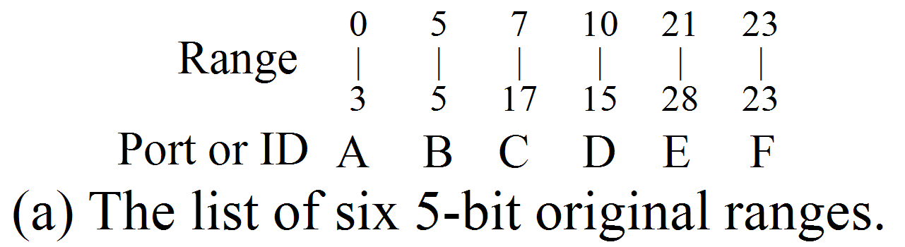
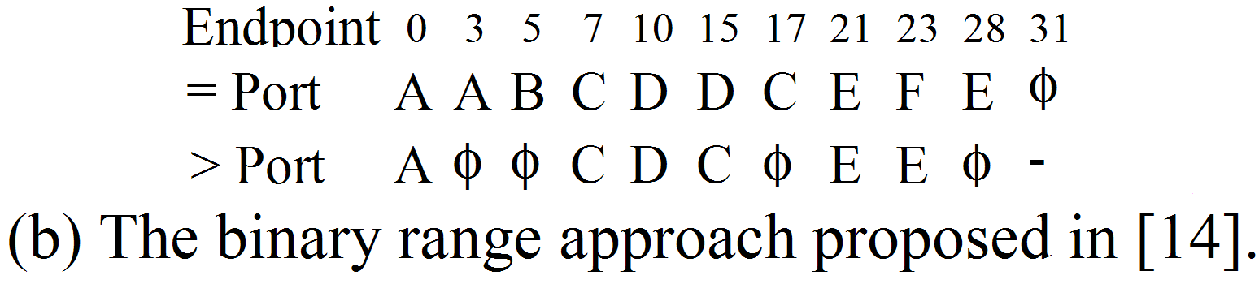
Existing Binary Range Search
Traditional Endpoint: [e, f] → e and f.

Slide 41
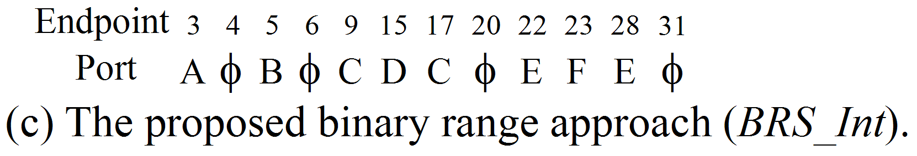
Proposed Binary Range Search
Proposed Endpoint: minus-1-endpoint
range [e, f] → e – 1 and f.

Slide 42
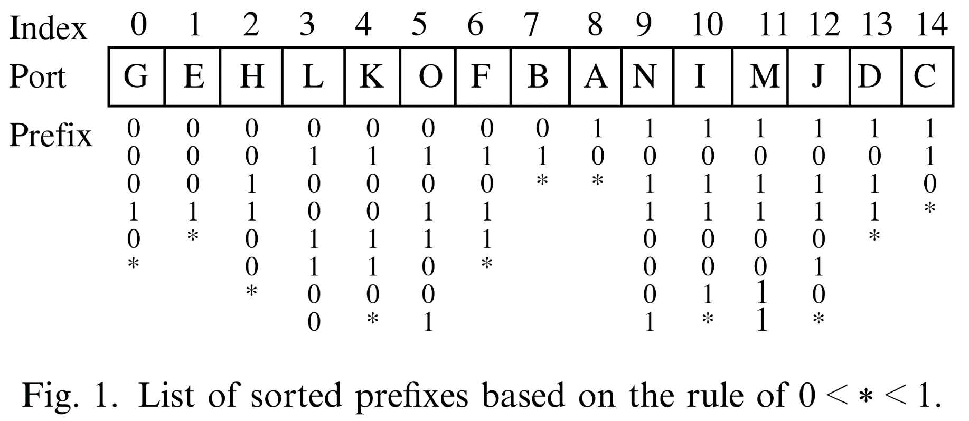
Binary prefix search
Definition 1 (Prefix comparison):
The inequality 0 < * < 1 is used to compare two prefixes in the ternary format.

Slide 43

Binary prefix search
Directly performing a binary search on the list of sorted prefixes may encounter a failure: Dst = 01011000
2
4
3
1
Correct match
Failed match

Slide 44
Binary prefix search
Enclosure relationship between prefixes results in the search failure
Generate some auxiliary prefixes that inherit the routing information of the original LPM (e.g., F) and put them where the binary search operations can find them. ex. auxiliary prefix 01011000.
Therefore, it is feasible to split prefix F into two parts such that both sides of prefix O are covered.

Slide 45
Binary prefix search
The full tree expansion.
The full tree expansion splits the enclosure prefixes into many longer prefixes (leaf pushing).
Auxiliary prefix merges
Many auxiliary prefixes may inherit the same routing information of a common enclosure prefix. These prefixes can be merged into one. The merge operation is defined as follows.
Prefix merge:
The prefix obtained by merging a set of consecutive prefixes is the longest common ancestor (LCA) of these consecutive prefixes in the binary trie.

Slide 46
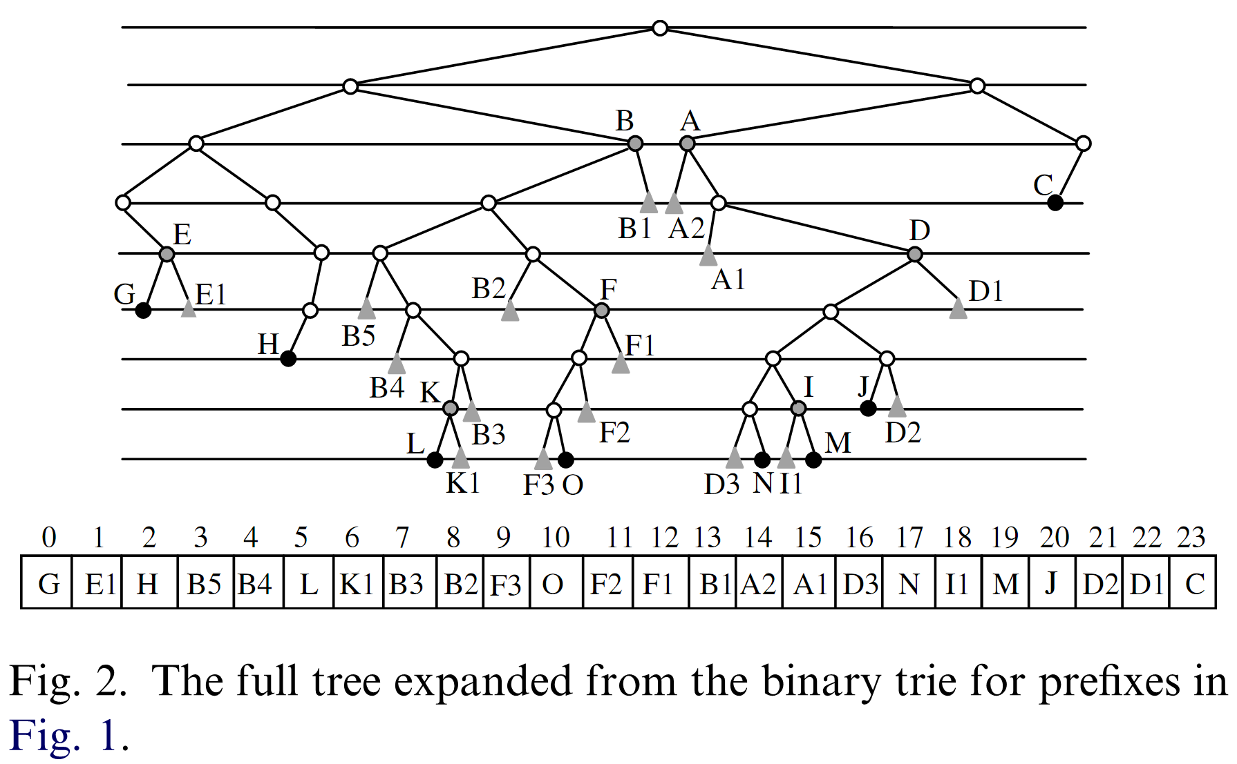
Binary prefix search
The full tree expansion
F3=01011000

Slide 47
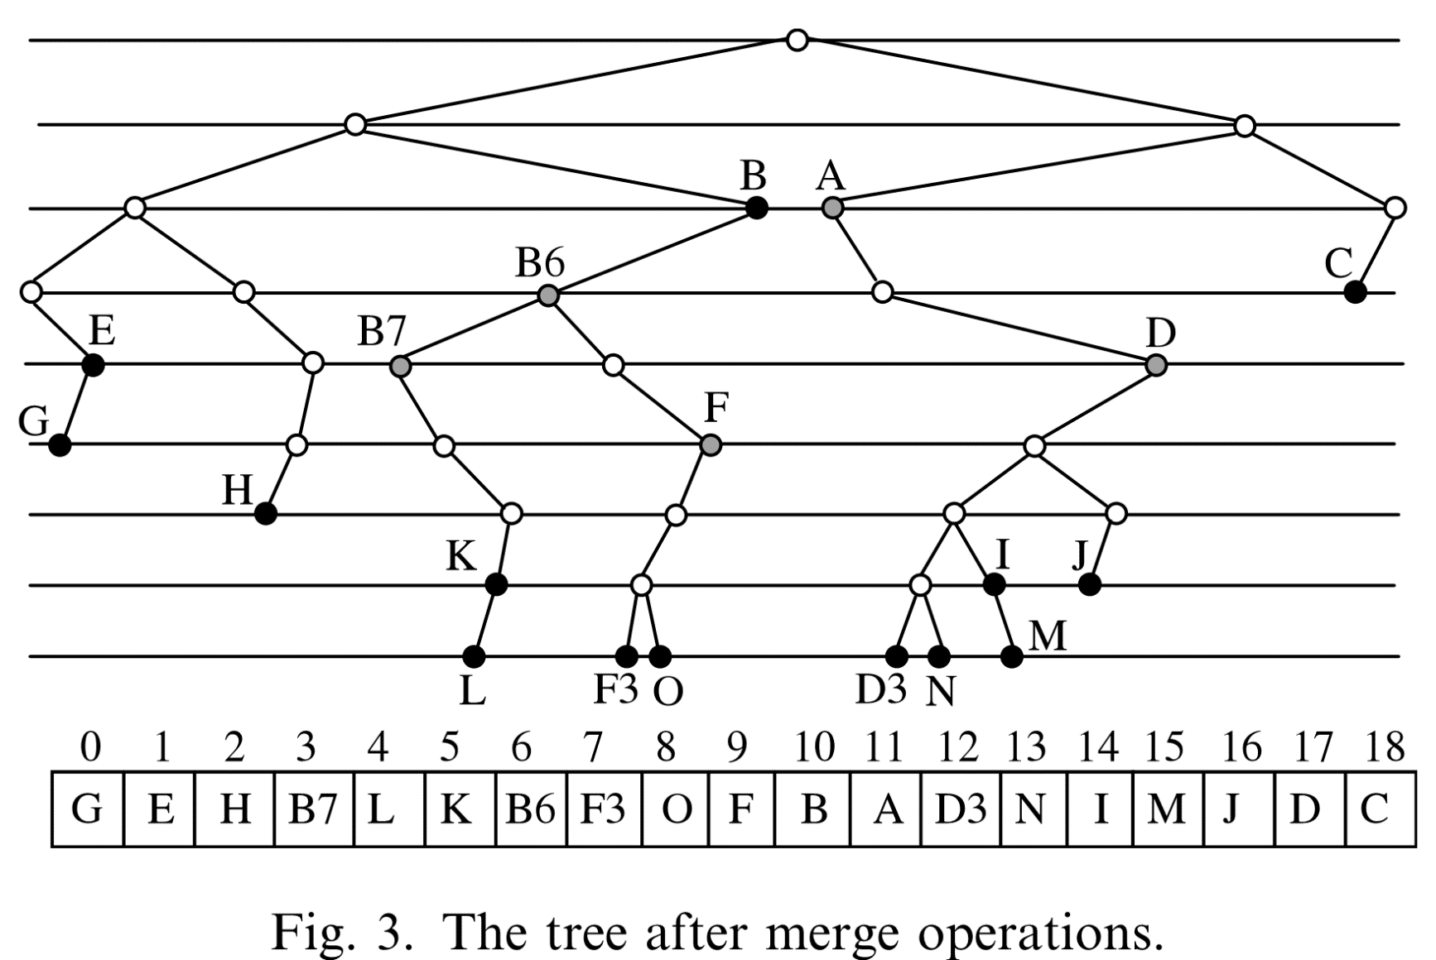
Binary prefix search
The full tree after the merge operations
F3=01011000

Slide 48
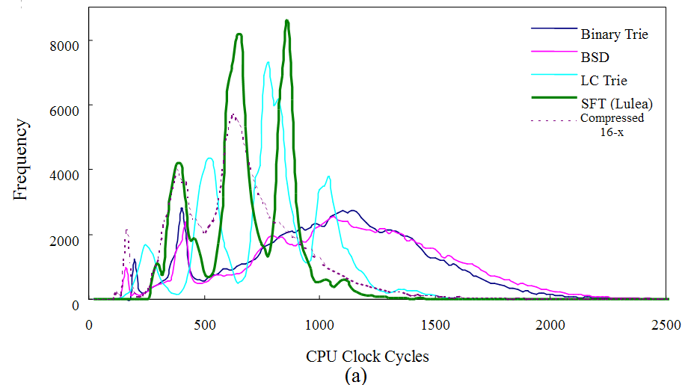
Performance: Search Speed

Slide 49
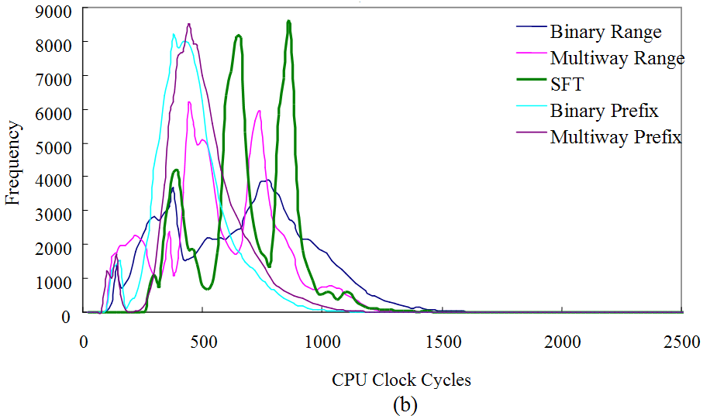
Performance: Search Speed

Slide 50
  Table 3: For 120,635 prefixes and multiway assumes 64-byte cache block.
Scheme
Segmentation
Statistics
Ref.
Memory
Original table
N/A
# of prefixes: 120,635 (45 bits each)
N/A
662.7 KB
Binary trie
16-bit segmentation
65535 entries
(4 byte each)
# of nodes: 320,478 (7 bytes each)
8/32
2,447 KB
BSD trie
# of nodes: 222,334 (8 bytes each)
8/26
1,993 KB
Compressed
16-x
Base array: 427 KB
Compressed Bit-map: 427 KB
CNHA: 37.9 KB
1/3
1,147 KB
LC trie
Branch factor: 16
Fill factor: 0.5
# of nodes: 259,371 (4 bytes each)
Base vector: 110,679 (16 bytes each)
Prefix vector: 9,927 (12 bytes each)
Next Hop vector: 255 (4 bytes each)
1/5
2,859 KB
SFT
level-1 pointers:
13,317
level-2 pointers:
461
(4 bytes each)
# of segments (avg # of prefixes per segment)
Sparse: 2,765 (2.9)
Dense: 4,300 (25.5)
Very dense: 586 (91.7)
Maptable: 5.3K
Base array: 2K
Code Word array: 8K
1/12
649.9 KB
Binary range
No segmentation
# of prefixes: 232,887 (6 bytes each)
1/6
1,365 KB
Binary range
16-bit segmentation
# of prefixes: 217,146 (4 bytes each)
1/4
1,104 KB
Multiway range
16-bit segmentation
# of blocks: 71,034 (64 bytes each)
1/4
4,695 KB
Binary prefix
No segmentation
# of prefixes: 145,737 (5 bytes each)
1/5
646 KB
Binary prefix
16-bit segmentation
# of prefixes: 117,968 (3 bytes each)
1/4
601 KB
Multiway prefix
16-bit segmentation
# of blocks: 11,175 (64 bytes each)
1/3
954.4KB

Slide 51
Goal of hardware approaches
Pipeline architecture to achieve the throughput of over 100Gbps
The most popular design is based on multibit trie
Advantages
  Simple
  Bubble instruction to perform updates
Disadvantages
  Unbalanced memory among stages (solvable)
  Memory requirement is too large to fit in the on-chip memory of hardware device such as FPGA

Slide 52
Multibit trie pipeline
Pipeline registers
52

Slide 53
References for existing pipelines
Ring - ISCA-2005-A Tree Based Router Search Engine Architecture with Single Port Memories
SDP - SIGCOMM-2005-Dynamic Pipelining Making IPLookup
CAMP - ANCS-2006-CAMP：Fast and Efficient IP Lookup Architecture
OLP - HOTI-2007-A Memory-Balanced Linear Pipeline Architecture for Trie-based IP Lookup
BiOLP - FCCM-2008-A SRAM-based Architecture for Trie-based IP Lookup Using FPGA
DuPI - FPL-2008-Scalable high-throughput SRAM-based architecture for IP-lookup using FPGA

Slide 54
References for existing pipelines
Hash - HotI-2008-An Efficient Hardware-based Multi-hash Scheme for High Speed IP Lookup
POLP - INFOCOM-2008-Beyond TCAM-An SRAM based parallel multi-pipeline architecture for terabit IP lookup
POLP - IPDPS-2008-Parallel IP Lookup Using Multiple SRAM-based Pipelines
FlashLook - HPSR-2009-FlashLook 100Gbps Hash-Tuned Route Lookup Architecture
FPL - HPSR-2009-Frugal IP Lookup Based on a Parallel Search
pDST - FPGA-2010-High Throughput and Large Capacity Pipelined Dynamic Search Tree on FPGA
FlashTrie - INFOCOM-2010-FlashTrie- Hash-based Prefix-Compressed Trie for IP Route Lookup Beyond 100Gbps

Slide 55
References for existing pipelines
DMST - TC-2010-Dynamic Multiway Segment Tree for IP Lookups and the Fast Pipelined Search Engine
BPFL & POLP - HPSR-2011-FPGA implementation of lookup algorithms
Shuffled Trie - ICC-2011-Bit-Shuffled Trie IP Lookup with Multi-Level Index Tables
Prefix Partitioning - TC-2011-Scalable Tree-based Architectures for IPv4v6 Lookup Using Prefix Partitioning

Slide 56
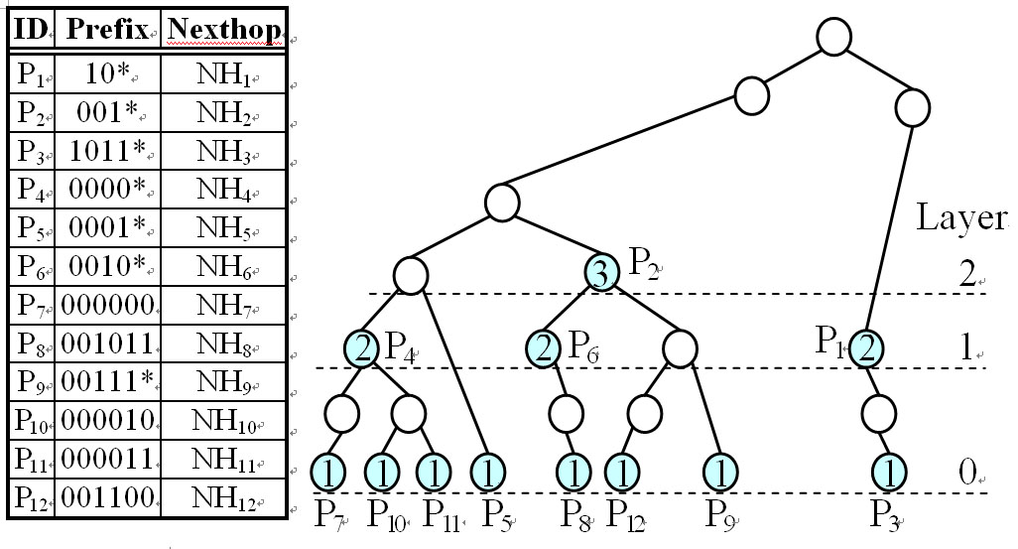
B-Tree structure

Slide 57
B-tree structure
layer 0
12
P₅
88
P₃
2
P₇
5
P₁₀
7
P₁₁
22
P₈
25
P₁₂
30
P₉
layer 1
4
P₄
20
P₆
72
P₁
layer 2
24
P₂
Notes:
more compact → 省 node → 降低 memory consumption
57

Slide 58
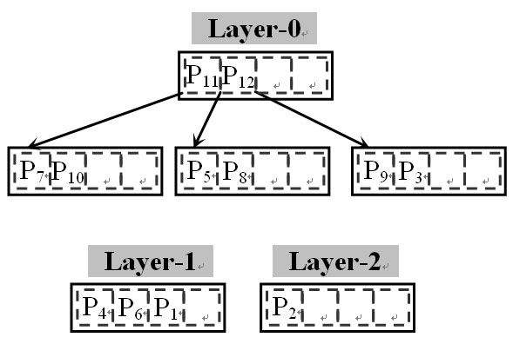
B-Tree structure

Slide 59
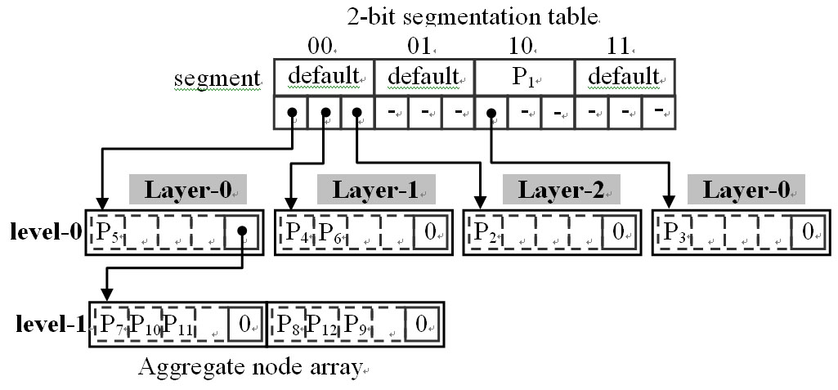
B-Tree structure

Slide 60
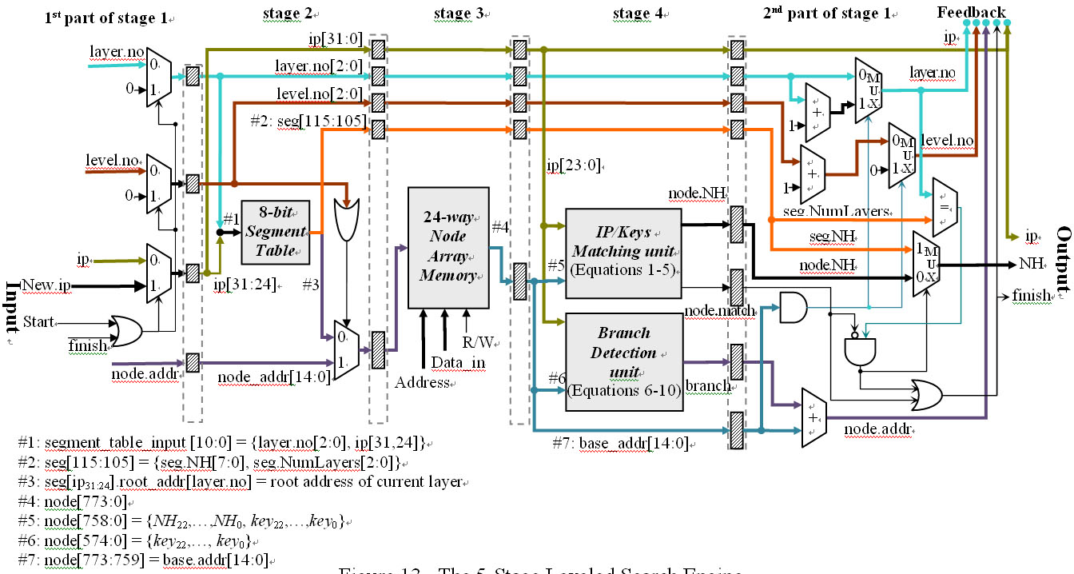
Search Engine

Slide 61
Matching unit
ip and key_{x} are matched

Slide 62
Branch Detection Unit

Slide 63
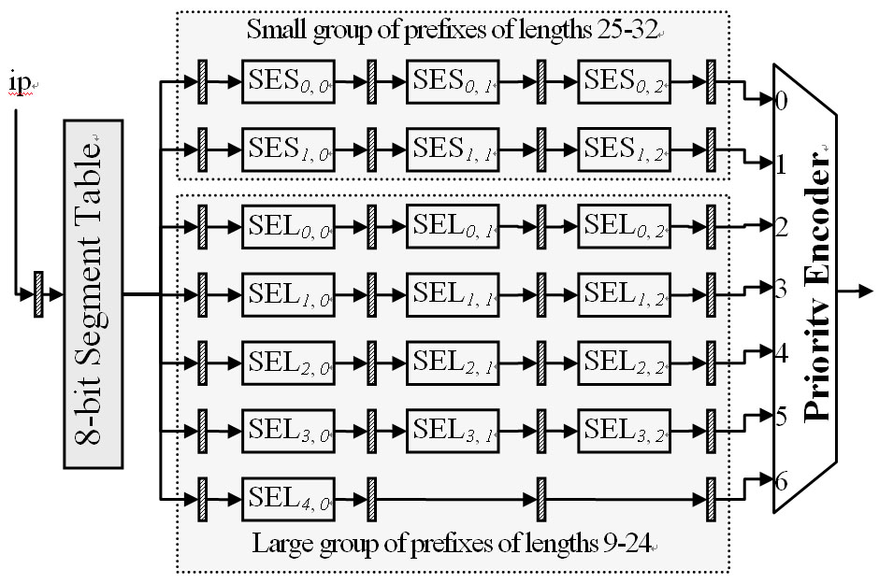

Slide 64
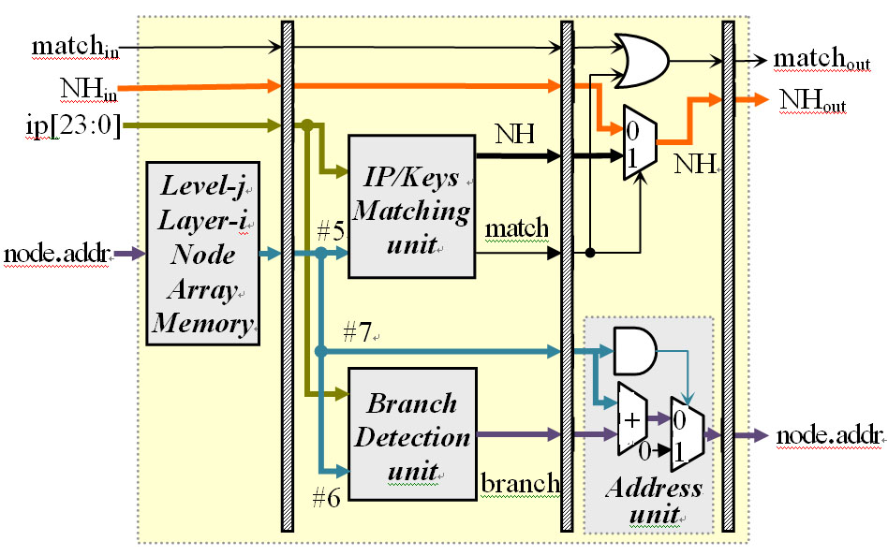

Slide 65
Prefix Enclosure Analysis (1/2)
Routing Table |  | AS6447 (2005-4) | AS6447 (2009-7) | AS6447 (2011-5)
size |  | 163,535 | 301,552 | 369,394
Layer | 0 | 150,245 (91.9%) | 273,944 (90.8%) | 334,445 (90.5%)
 | 1 | 11,135 (6.8%) | 23,171 (7.7%) | 28,930 (7.8%)
 | 2 | 1,775 (1.1%) | 3,690 (1.2%) | 4,870 (1.3%)
 | 3 | 329 (0.2%) | 628 (0.2%) | 926 (0.3%)
 | 4 | 45 | 101 | 177
 | 5 | 6 | 16 | 30
 | 6 | 0 | 2 | 12
 | 7 | 0 | 0 | 4

Slide 66
Prefix Enclosure Analysis (2/2)
After small push
Routing Table |  | AS6447 (2005-4) |  | AS6447 (2009-7) |  | AS6447 (2011-5)
size |  | 163,535 |  | 301,552 |  | 355,893
length |  | 9-24 | 25-32 | 9-24 | 25-32 | 9-24 | 25-32
Layer | 0 | 7,071 | 3,488 | 271,548 | 5,736 | 333,034 | 5579
 | 1 | 496 | 67 | 17,081 | 28 | 20,884 | 21
 | 2 | 54 | 0 | 1,488 | 0 | 1,859 | 0
 | 3 | 6 |  | 88 |  | 111
 | 4 | 0 |  | 2 |  | 5

Slide 67
Performance Comparisons
Scheme | FPGA Device |  | Configurable logic (slice) | Memory (Mbits) | # of prefixes | ME ratio bits/prefix | Clock rate (ns) | # of accessed nodes / search |  | Throughput
 |  |  |  |  |  |  |  |  |  | Mpps |  | Gbps
 |  |  |  |  |  |  |  | avg | worst | avg | worst | avg | worst
LSE | Virtex-6 XC6VSX315T |  | 1,402 (2.8%) | 10.9 | 301,552 | 37.0 | 3.157 | 3.02 | 13 | 104.9 | 24.4 | 33.6 | 7.8
Parallel LSE |  |  | 7,408 (15%) | 10.8 |  | 36.8 | 2.649 | 1 |  | 377.5 |  | 120.8
DMST [7] | Virtex-5 VLX330T | Original | 463 (1%) | 11.68 | 163,574 | 74.9 | 5.00 | 4.68 | 6 | 42.7 | 33.3 | 21.9 | 17.1
 |  | Extended | 2,778 (6%) |  |  | 74.9 | 5.00 | 1.0 |  | 200 |  | 102
Ring [1] | Virtex-2P XC2VP70 |  | 408 (1%) | 3.49 | 30,000 | 116.4 | 4.00 | 2.0 |  | 125 |  | 40
CAMP [11] |  |  | 528 (2%) | 3.89 |  | 129.6 |  | 1.3 |  | 200 |  | 64
OLP [10] |  |  | 362 (1%) | 3.46 |  | 115.2 |  | 1.0 |  | 250 |  | 80
BiOLP^{(a)}[12] | Virtex-4 FX140 |  | 1,785 (3%) | 9.54 | 83,662 | 114.0 | 3.069 | 1.0 |  | 325 |  | 104
BPFL^{(a)} [23] | Stratix II EP2S180F1020C5 |  | 27.9K LE ^{(b)} (19%) | 5.6 | 309,000 | 18.1 | 10.35 | 1.0 |  | 96.6 |  | 30.9
POLP^{(a)} [23] |  |  | 6.6K LE ^{(b)} (5%) | 9.08 |  | 29.4 | 9.29 | 1.0 |  | 107.6 |  | 34.4
pDST^{(d)} [44] | Virtex-5 LX330 |  | 12.8k LUTs(6.3%) | 7.112 | 96,000 | 75.86 | 7.4 | 1.0 |  | 242 |  | 77.4
BSTrie^{(a)} [22] | Virtex-5 XC5VSX240T |  | 749 (2%) | 7.38 | 321,000 | 23.0 | 5.7 | 1.0 |  | 175 |  | 56
Notes: (a) the next hops are not stored in on-chip memory. (b) Instead of slices, Stratix LEs are used. (c) It is the non-cache based BiOLP.(d) dual-ported block RAM is used
Y.-K. Chang, F.-C. Kuo, H.-J. Kuo, C.-C. Su, "LayeredTrees: Most Specific Prefix based Pipelined Design for
On-Chip IP Address Lookups", IEEE Transactions on Computers, Vol. 63, No. 12, December 2014.

Slide 68
5D Packet Classification
performed by routers to classify the incoming packets into flows according to a set of rules
If a packet matches multiple rules, the matching rule with the highest priority is returned.
Typically, each rule contains five fields,
  Source IP address,
  destination IP address,
  source port number,
  destination port number,
  protocol type

Slide 69
A real-life classifier in five dimensions
Rule Dst. IP Src. IP Dst port Src port Protocol # Action
R1 140.116.246.69/32 140.116.82.11/32 * * * Deny
R2 140.126.53.0/24 140.116.100.157/32 80 * tcp Deny
R3 140.116.247.4/32 140.116.160.0/24 > 1023 * udp Permit
R4 0.0.0.0/0 0.0.0.0/0 * * * Permit
prefix
range
Classification examples
PKT Dst. IP Src. IP Dst port Src port Protoc # Action
P1 140.116.246.69 140.116.82.11 80 1222 tcp Deny,R1
P2 140.126.53.10 140.116.100.57 80 1233 udp Deny,R2
P3 140.116.247.4 140.116.160.10 1024 1235 tcp Permit,R3

Slide 70
David Taylor’s Survey (Before 2003)
Exhaustive Search
Decomposition
Crossproducting
TCAM
RFC
ABV
Linear Search
E-TCAM
Pruned
Tuple Space
EGT
HiCuts
Grid-of-Tries*
Tuple Space
FIS Trees
Rectangle
Search
Decision Tree
Tuple Space

Slide 71
Packet Classification
David E. Taylor, Survey & Taxonomy of Packet Classification Techniques, ACM Computing Surveys, Volume 37, Issue 3, 238-275, September 2005.
Hierarchical trie, set-prunning trie, grid of trie
Hierarchical binary search structures
Hierarchical, set-prunning, grid of segment tree
2-phase schemes, 5 independent 1-D search+merge
  Lucent Bit vector
  Cross-product + Bloom Filter
  TCAM range encoding
FPGA pipelined implementation (over 50Gbps)
  USC Prashana’s group

Slide 72
Packet Classification solution
Hardware (ASIC and FPGA) are usually adopted because of extremely high classification rate, but difficult to upgrade to other platforms to support new applications or consume too much electric power and board area for large classifiers
TCAM: Ternary Content Addressable Memory
Network processor is a programmable processor designed for network applications with the advantages of high performance of ASIC and the programming flexibility.
SRAM: Algorithm + Data structure

Slide 73
HiCuts vs HyperCuts
HiCuts builds a decision tree using local optimization decisions at each node to choose the next dimension to test how many cuts to make in the chosen dimension.
  The leaves of HiCuts tree store a list of rules that may match input packet header field values.
HyperCuts is also a decision tree structure, in which many dimensions are considered altogether instead of one dimension at a time in Hicuts, in order to reduce the height of decision tree.

Slide 74


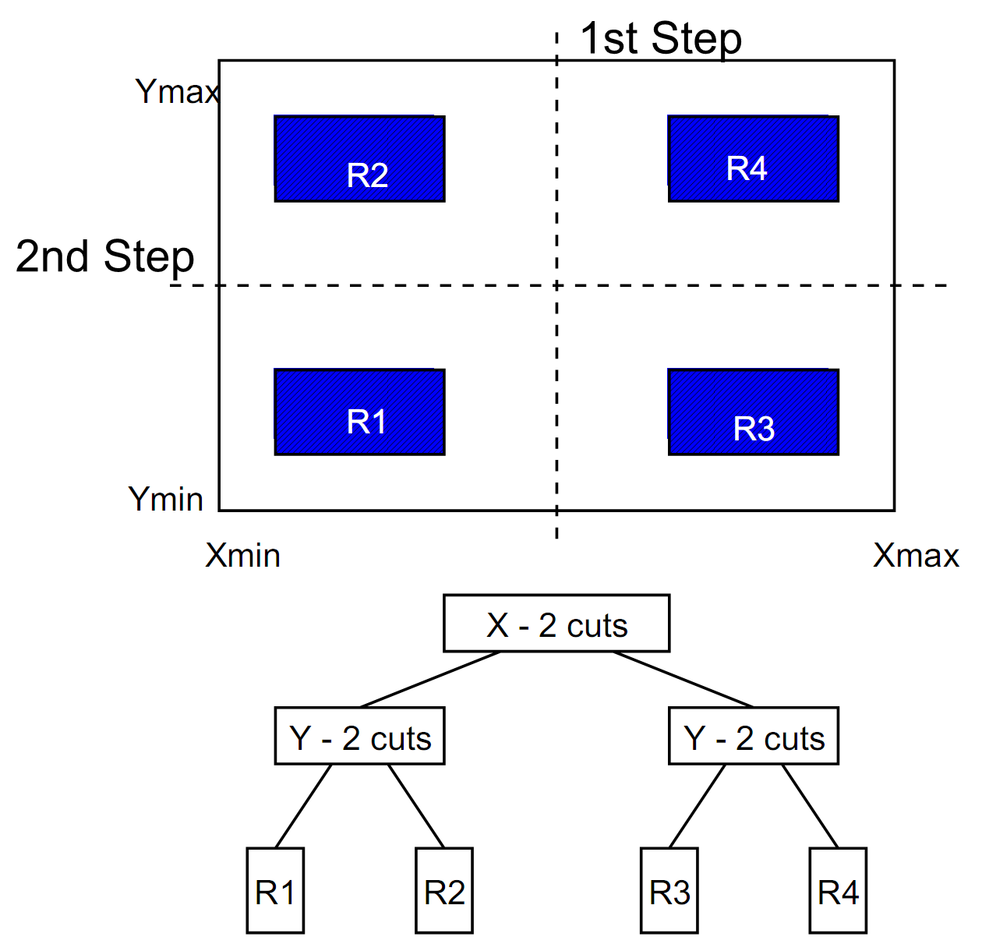
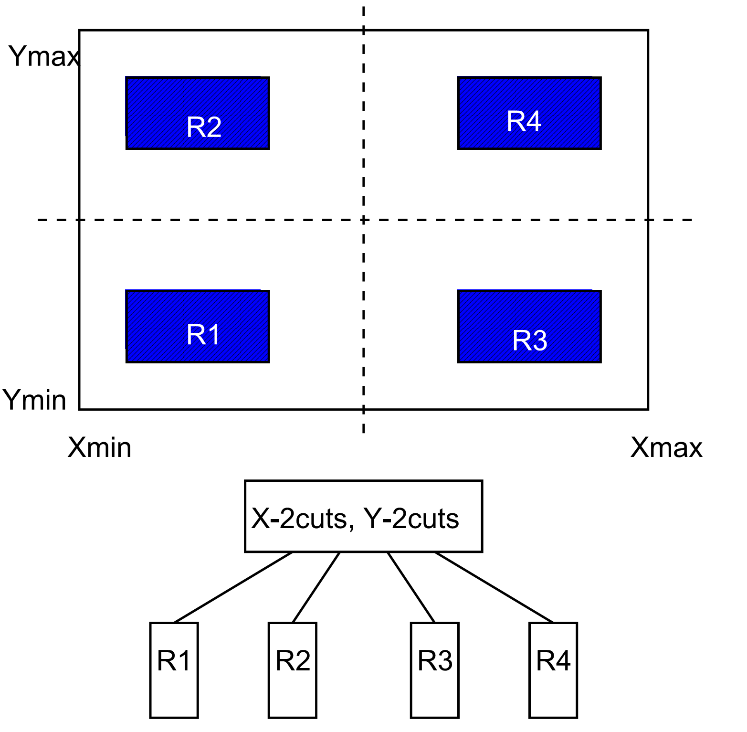
HiCuts vs HyperCuts(con.)

Slide 75
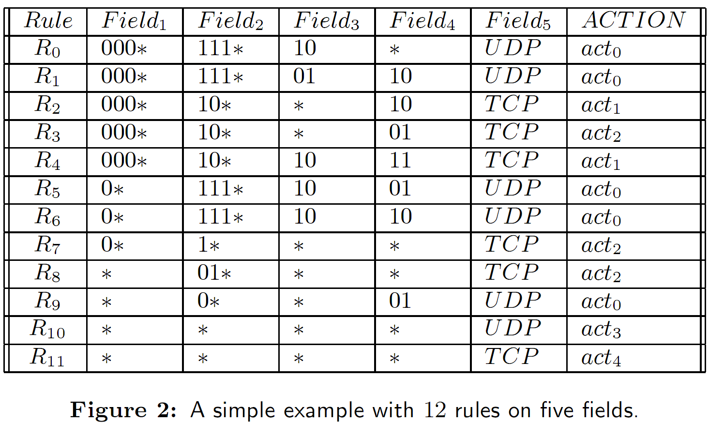
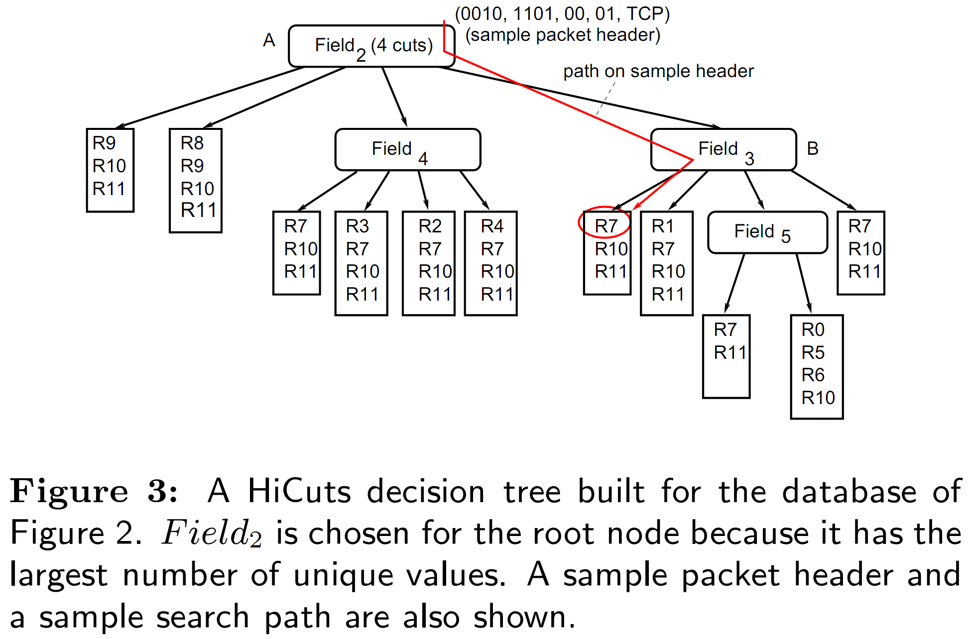
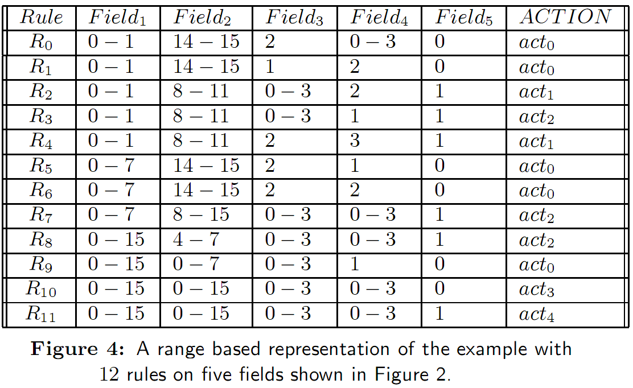
HiCuts Example
Bucket size = 4
00
01
10
11

Slide 76
Hicuts: how to decide np?
A large np(C) decreases the tree depth (accelerate query time) at the expense of increasing storage.
sm(C(v)) = ∑ NumRules(child_{i}) + np(C(v))
  sm = space measure and v is the node to be cut
spfac * NumRules(v) ≥ sm(C(v))
This is done by a simple binary search on the number of cuttings till sm(C(v)) gets “close” enough to spmf(NumRules(v))= spfac * NumRules(v)

Slide 77
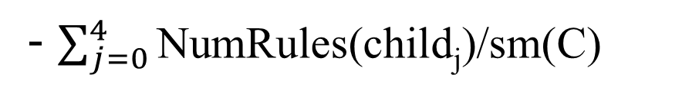
Hicuts: How to pick which dimension to cut?
Minimizing max_{j}(NumRules(child_{j})) to decrease the worst-case depth of the tree
Maximizing
Treating NumRules(child_{j})/sm(C) as a probability distribution with np(C) elements, and maximizing the entropy of the distribution. Intuitively, this attempts to pick a dimension that leads to the most uniform distribution of rules across nodes;
Minimize sm(C) over all dimensions
Choose the dimension that has the largest number of distinct range specifications of filters.

Slide 78
Hicuts Optimization
Rule overlap :
higher priority rule covering lower priority rule eliminate the latter.
Use the same pointer pointing to identical children containing the same set of rules

Slide 79
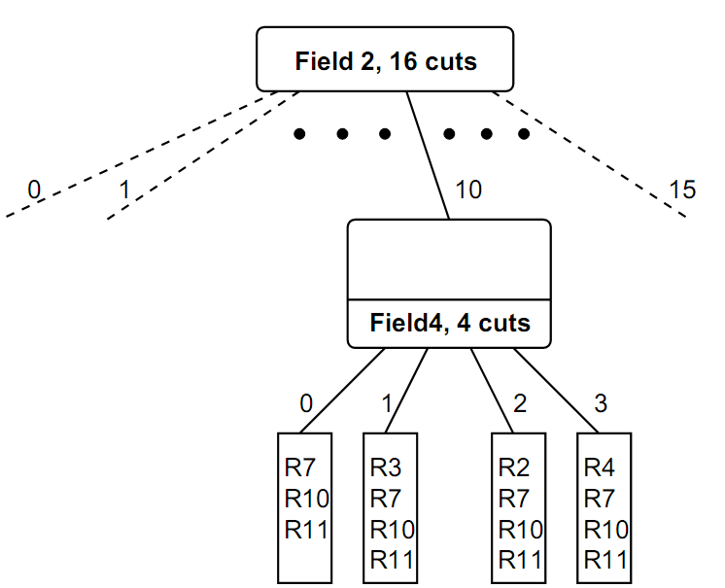
HyperCuts Example
No HiCuts tree for database in Figure 2 can have height of 1.
Even the number of cuts in Field2 is set to the max number of 16, the region associated with Field2 = 10 still has 6 rules.

Slide 80
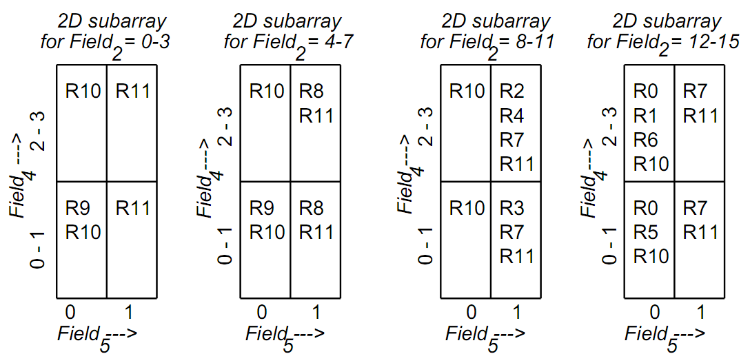
HyperCuts Example
Bucket size = 4
The HyperCuts decision tree built using 4 cuts on Field2, and 2 cuts each on Field4 and Field5.
Contrast this single node tree with Figure 5 which shows that any HiCuts tree must have height at least two.

Slide 81
Observations on HyperCuts
i. The decision tree should try at each step (node) to eliminate as many rules as possible from further consideration.
ii. The maximum number of steps to be taken during a search should be minimized.
iii. Certain rules may not be able to be segregated without a further increase in the overall complexity of the algorithm (both space and time). Therefore a separate approach should be taken to deal with them.
iv. As in any packet classification scheme there is always a tradeoff between the search time and the memory space occupied by the search structures.

Slide 82
Hypercut: How to pick dimensions
Consider the set of dimensions for which the number of unique elements is greater than the mean of the number of unique elements for all the dimensions under consideration.
For example, if for the five dimensions the number of unique elements in each of the dimensions are: 45, 15, 35, 10 and 3 with a mean of 22, then the dimensions which should be selected for splitting are the first and the third.

Slide 83
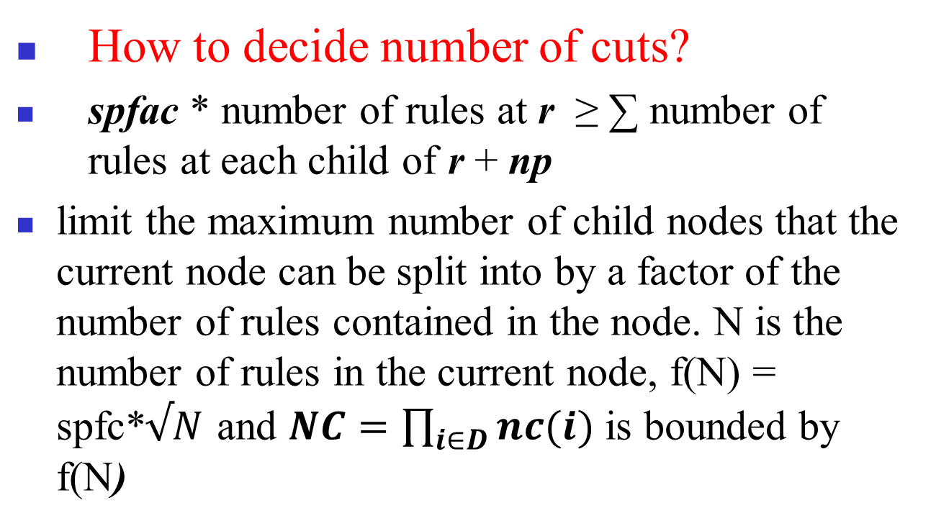
Hypercut

Slide 84
Hypercut Optimization (1/2)
Node merging
2. Rule overlap :
higher priority rule cover lower priority rule eliminate the latter.

Slide 85
Hypercut Optimization (2/2)
3. Region compaction
4. Pushing common rule subset upward3

Slide 86
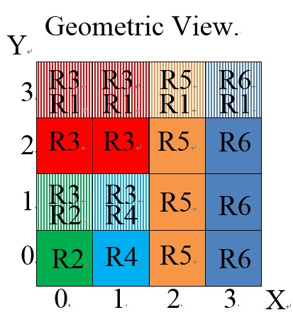
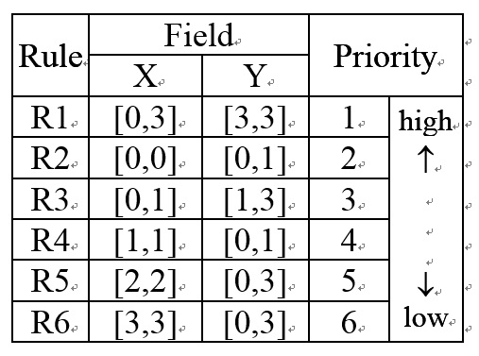
HiSplit and HyperSplit
1. Similar to HiCuts and HyperCuts
2. Endpoints of ranges instead of prefixes
3. Cut the decision tree at endpoints instead of bits

Slide 87
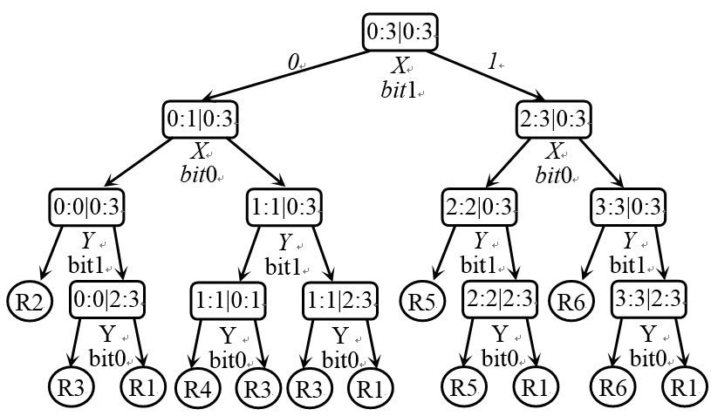
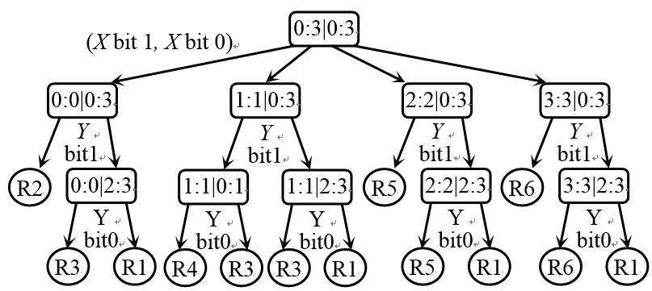
hicuts
hypercuts

Slide 88
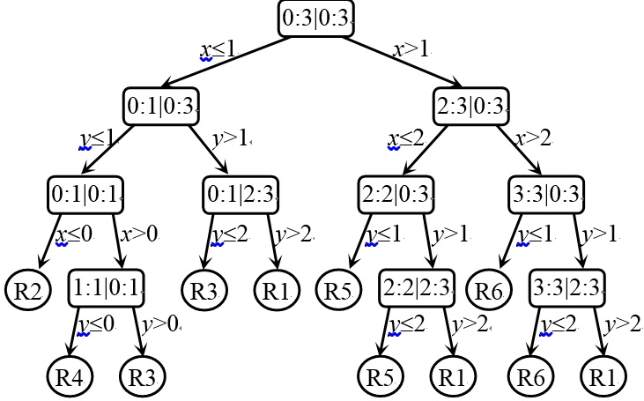
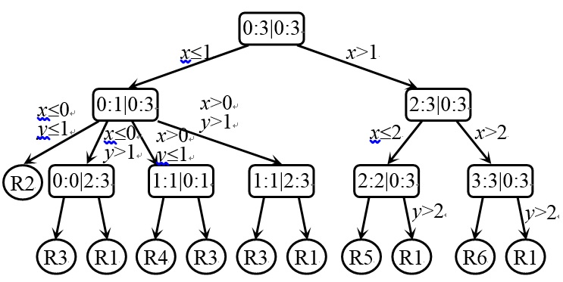
hypersplit
new
hypersplit

Slide 89
Rule duplication problem
Don’t care values in many fields
Solution: partition rule set into subset
1. Efficuts: use don’t care
2. recursive partition: avoid store rules in internals nodes of the hierarchical structure

Slide 90
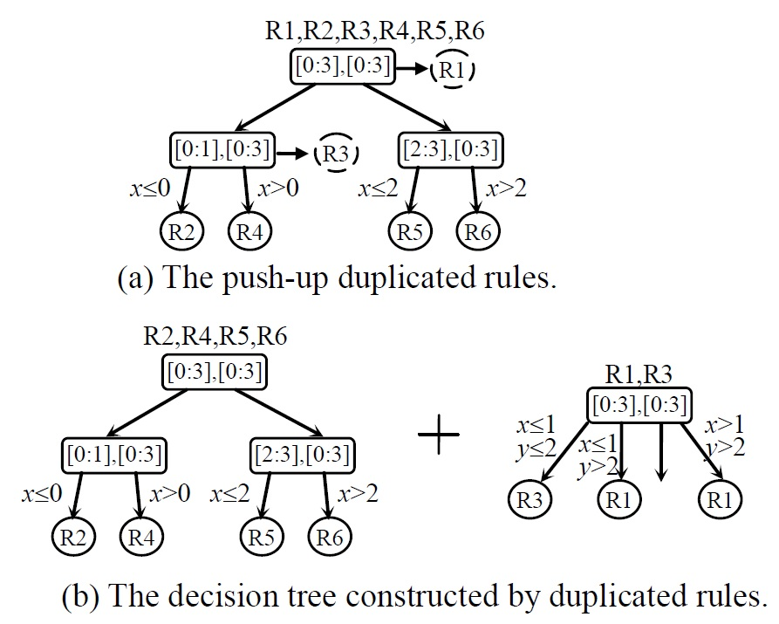
Recursive Partition

Slide 91
Software Defined Network (SDN)
Openflow

Slide 92
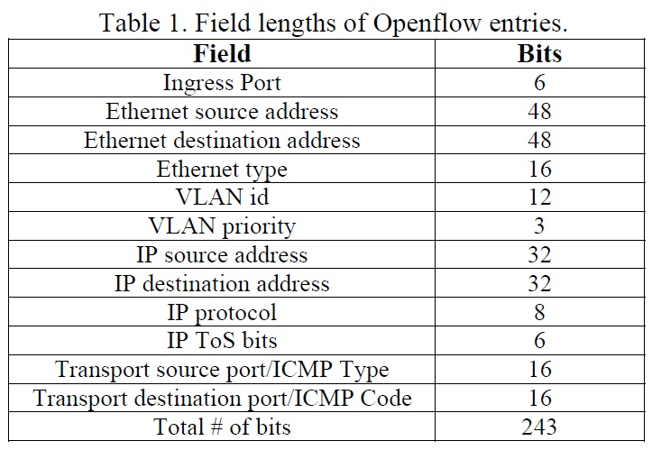
Openflow version 1

Slide 93
Building Balanced Search Tree based on Layered Decision Tree for Packet Classification
基於分層決策樹之封包分類平衡搜尋樹

Slide 94
Range Enhanced Packet Classification Design on FPGA
基於FPGA之改善Range搜尋的封包分類設計

